Slide 1
Helping to Secure Your Clients’ Retirement
Transforming Social Security Into a Winning Retirement Strategy
This material is provided for educational purposes only and does not constitute investment advice. The information contained herein is based on current tax laws, which may change in the future. BlackRock cannot be held responsible for any direct or incidental loss resulting from applying any of the information provided in this publication or from any other source mentioned. The information provided in these materials does not constitute any legal, tax or accounting advice. Please consult with a qualified professional for this type of advice.
Notes:
Hi, my name is [Insert Name] and I’m here today to talk to you about Social Security and to provide strategies to help your clients who are between ages 55 and 65, those clients most likely to collect Social Security as we know it today, maximize the benefits they can expect to receive from Social Security. Getting as much money back from the government as possible is likely something that is important to all your clients, not just those who need the income.
So today, to help you become more familiar and comfortable with the current rules as well as discuss collection strategies including collecting benefits at age 62 as well as waiting until full retirement age or even age 70.

Slide 2
Living Longer
Life Expectancy Upon Retirement at Age 65
50% chance of living to
25% chance of living to
50% chance of living to
25% chance of living to
at least 1 person has a 50% chance of living to
at least 1 person has a 25% chance of living to
A healthy 65-year-old female has a 50% chance of living until age 89 (24 more years).
Source: Society of Actuaries’ Annuity RP-2014 Total Healthy Annuitant rates, Scale MP-2014. Figures assume you are in good health.
Notes:
Many of you I’m sure are aware of the medical advances and healthier lifestyles have increased longevity. A couple who reaches 65 has a 50% chance to living into their early 90’s and 25% into their late 90’s. So we can assume from these statistics 1 person from a couple will live into their 90s. However people are not taking longevity into account when taking their benefits.

Slide 3
But Still Collecting Early
Source: Social Security Administration’s Annual statistical supplement, 2013.
Notes:
In fact 73% of people collecting Social Security benefits today are collecting reduced amounts because they collected early, often as early as age 62. Why, in the face of longevity, do many people collect benefits when they hit age 62? Probably because they can. Even though so many of our client's are concerned with longevity, they are willing to except reduced benefits for life to avoid not getting their fair share of benefits because they may die early.
But longevity is a reality. In 2012 there were over 1.9 million people over the age of 90 collecting Social Security benefits. There were about 55,000 people over the age of 100 collecting benefits.
Source: Table 5.A10

Slide 4
Rules of Retirement Benefits
Individual Benefits
Notes:
Now let’s dive into some of the rules.

Slide 5
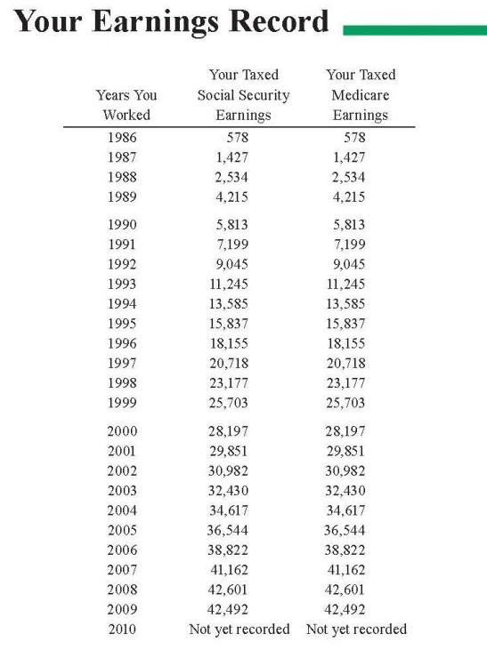
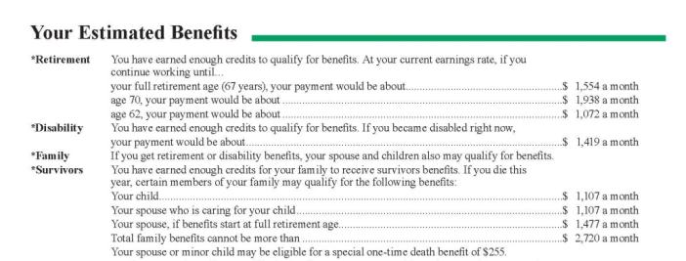
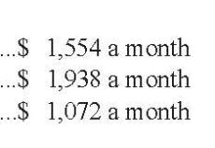
Individual Benefits
Best 35 Years
Online Statements or Retirement Estimator
www.ssa.gov
Source: Social Security Administration (www.ssa.gov).
Notes:
Most workers pay into the program with each paycheck and will qualify for Social Security benefits at retirement. Workers pays FICA tax up to the Social Security wage base ($118,500 in 2015) toward Social Security. This amount is matched by the worker’s employer. To be fully insured, a worker needs 40 credits. A maximum of 4 credits can be earned per year. For 2015, one credit is earned for every $1,220 of wages.
Currently, any of your clients who are paying FICA taxes and are at least age 60 should be receiving a Social Security benefits statement in the mail about three months before their birthday. This statement includes their earnings record on page 3. You should encourage them to check this carefully because their benefits will be based off this record, mistakes and all. If they spot any mistakes, have them call the Social Security administration to correct them.
Benefits are based on the best 35 years of work history and the benefits reflected on your statement reflect the assumption that the client will continue to earn his or her current salary (from the last two years) until they begin to collect benefits.
You should also review the information on page 2 with your clients. This is where they will find three key numbers: their monthly benefits if they elect to collect at their full retirement age, their monthly benefits if they collect at age 70 and their monthly benefits if they collect at age 62.
The Social Security Administration has a calculator on their website which will allow you and your clients to modify the expected retirement date and wage assumptions to create a more accurate estimate of expected benefits.

Slide 6
The Tradeoff for Individual Benefits
Full Retirement Age
Age 62
Age 70
Reduced Benefits
Increased Benefits
Primary Insurance Amount (PIA)
Full Retirement Age (FRA)
65
1937 or earlier
66
1943-1954
67
1960 and later
Source: Social Security Administration (www.ssa.gov).
Notes:
Your clients have the option to start collecting their benefits anytime between age 62 and age 70. However, if they collect before full retirement age, they will collect reduced benefits. If they wait until full retirement age, they will be eligible for their full benefits (also known as their primary insurance amount). If they wait until after full retirement, they will be eligible for an increased benefit.
Full retirement age is not the same for everyone. For those born 1937 or earlier, it is 65. For those approaching retirement right now, it is right around age 66 which we will use as full retirement age for the remainder of the seminar.

Slide 7
Collecting Early: The Cost
Cost of Collecting Early
Percentage of FRA Benefits
Source: Social Security Administration (www.ssa.gov). Assumes full retirement age of 66.
Notes:
As we saw before, the majority of clients take benefits before full retirement age. If your client elects to take benefits early, their benefits will be permanently reduced. The payment is not adjusted when they reach FRA. Generally, your client's will look to you to do one of two things. If they collect early, they will look to you to, over the long run, make them better off despite their reduction. Or if they defer, they will need your help to bridge the income gap between age 62 and when they start collecting. What else should your clients consider before they go ahead and agree to a permanently reduced benefits?
Percentage of monthly reduction and total reductions are approx due to rounding. Actual reductions are 5/9 of 1% per month or .555 for the first 3 years and 5/12 of 1% (.416) for subsequent months.

Slide 8
Collecting Early: Consider These Questions
Working
Is the client actually retiring?
Will the client work, even part-time, before FRA?
Longevity
How is the client’s health?
Is there a expectation of longevity?
Spouse
Is the client married?
What is the age difference between spouses?
Whose benefits can the spouse collect?
Notes:
Among other things, your client needs to consider their current health, their family history of longevity, and, if they are married, the age difference between them and their spouse.
One extremely important consideration that could directly influence a client not to collect early, is whether or not they are actually retiring. Are they grabbing the benefit because they can? Or are they grabbing the benefit because they’re actually retiring and need the income?

Slide 9
Collecting Early: Continuing to Work
2015 Retirement Earnings Limit
Your Age | 2015 limit | What Happens Above the Limit
Under FRA | $15,720/year | $1 of benefits withheld per $2 of earnings above limit
Year reach FRA | $41,880/year | $1 of benefits withheld per $3 in earnings above limit for months prior to reaching FRA
Month reach FRA and beyond | None | Nothing
Applies to any retirement benefits collected before FRA.
Earnings limit looks at wages only.
Source: Social Security Administration (www.ssa.gov).
Notes:
Social Security benefits are intended to be supplemental retirement income. So the SSA really wants you to be retired when you collect them. Therefore, they will penalize clients for collecting early if they are not actually retired. If you collect benefits early, you will be subject to an annual earnings test which looks exclusively at salary. Prior to full retirement age, if you earn more than the threshold amount ($15,720 in 2015), you lose $1 of benefits for every $2 earned over the threshold. Now keep in mind, this is on top of already reduced benefits.
For the year in which you reach full retirement age, a different rule applies. The threshold is $41,880 in 2015. And the rule is that you lose $1 in benefits for every $3 in earnings over the threshold. Once full retirement age is reached (in August and beyond), there is no threshold so you can earn any amount after that with no reduction in benefits.
This applies to all retirement benefits – individual, spousal, child and survivor – collected before FRA.

Slide 10
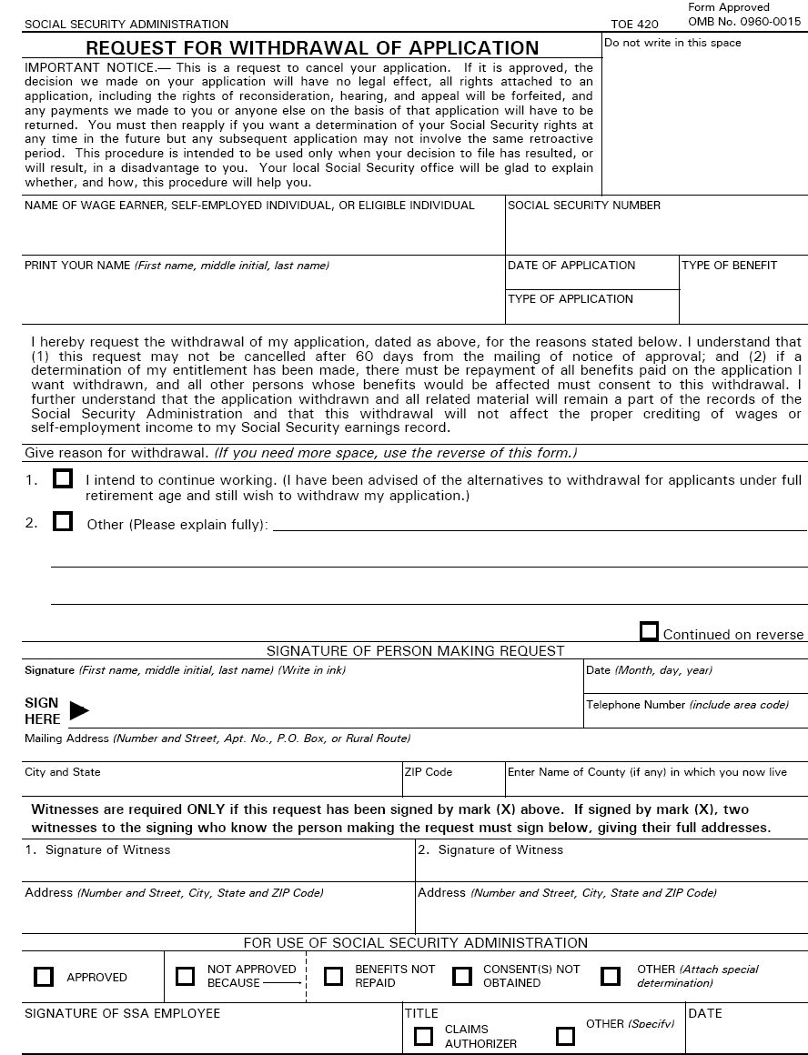
Changing Your Mind
Source: Social Security Administration (www.ssa.gov).
Notes:
If someone starts collecting their benefits prior to FRA and they find themselves returning to work and having their benefits withheld, they can consider a Withdrawal of Application. This essentially allows a client a do-over. The do-over provision is allowed only if the application is withdrawn within the first 12 months after starting benefits. Then the worker can repay benefits, and essentially start over. The unlimited “do-over” provision was prohibited by the SSA several years ago.
The benefits are simply suspended, and once the worker re-applies, SSA recalculates the worker’s benefit based on the revised work history.
They need to repay the SSA everything they had received to date, along with any family benefits paid on their work history, and then they can subsequently apply as if it were their first time applying.
The SSA has recently restricted the use of the Withdrawal to within 12 months of collecting benefits and will only allow one withdrawal per lifetime.

Slide 11
Collecting Late: The Guaranteed Increase
Increases for Collecting Late
Percentage of FRA Benefits
Source: Social Security Administration (www.ssa.gov). Assumes full retirement age of 66 and individual born in 1943 or later.
Notes:
So far we have discussed the drawback to collecting early or working when collecting benefits. Let’s switch gears to show what happens if your clients wait to collect benefits. They will be awarded guaranteed increases to their benefits of 8% per year (assuming they were born in 1943 or later) per year deferred beyond full retirement age up until age 70. For someone with a FRA of age 66, this could be an increase of 32% by age 70.

Slide 12
A Question of Longevity
Break Even Analysis
Age 82.5
Age 78
62
75%
of PIA
66
100%
of PIA
70
132%
of PIA
Notes:
Deciding what age to collect benefits as a single filer simply comes down to the question: How long do you think you will live? However by comparing payment cash flows you are able to determine a break even point that allows you to make a more informed decision.
Whether you start receiving lower benefits early or waiting and collecting a higher benefit amount later, at some point you will break even, which means you will receive the same amount of money no matter when you started collecting.
In the first example the break even analysis shows collecting at age 62 vs. collecting at full retirement age, in this example the break even point is the age of 78.
In the second example the breakeven when taking at FRA vs. 70 is 82 and 6 months. If you think you will live beyond 82 and 6 months, you might opt to receive larger checks later and begin collection at age 70.
While it’s impossible to know exactly how long you will live, you can make a reasonable guess about your current health and family history and looking at your break even age can help you when making your collection decision.

Slide 13
Rules of Retirement Benefits
Spousal and Survivor Benefits
Notes:
Now let’s dive into some of the rules.

Slide 14
Spousal Benefits
John
PIA: $2,200
Jane
PIA: $0
50% x $2,200
$1,100
Filing and Suspending
Age 62
FRA
Age 70
Collect
File
Suspend
Collect
File
Source: Social Security Administration (www.ssa.gov).
Notes:
Let’s take a look at John and Jane. John worked and his Primary Insurance Amount is $2,200. Jane did not pay work, therefore not paying into social security.
However Jane is eligible for a spousal benefit, 50% of John’s PIA, which is $1,100.
In order to be eligible for this benefit, John must first file for benefits. If he’s at least age 62 but less than FRA, once he files, he would be forced to collect (and his benefits would be appropriately reduced). If he waits until after FRA to file for benefits, he can opt to suspend his benefits (aka use a voluntary suspension of benefits) and then start collecting increased benefits at a later date. Either way, once John files for benefits, Jane becomes eligible for her spousal benefit.

Slide 15
Spousal Benefits
Maximum Spousal Benefit Amount
150%
100%
100%
100%
100%
100%
100%
92%
83%
75%
Percentage of FRA Spousal Benefits
70%
50%
0%
Age 62
Age 63
Age 64
Age 65
Age 66
Age 67
Age 68
Age 69
Age 70
(FRA)
Source: Social Security Administration (www.ssa.gov).
Notes:
Based on when Jane collects those benefits can impact the total she takes home. If she collects spousal benefits before FRA, her spousal benefits will be reduced. On the other hand, she is not rewarded for waiting beyond FRA. Spousal benefits do not receive delayed retirement credits, so there’s little incentive to wait to collect beyond full retirement age.

Slide 16
Adding Spousal Benefits to Individual Benefits
John
PIA: $2,200
Jane
PIA: $600
$1,200
$1,100
$1,000
$1,100 Max
Spousal
$308
Spousal
$500
$800
$800
-30%
Spousal
$350
$600
+32%
Own
$792
$400
-25%
Own
$600
Own
$450
$200
$0
Age 62
Age 66 (FRA)
Age 70
Source: Social Security Administration (www.ssa.gov).
Notes:
So how does this all work?
If Jane collected her own benefits at FRA, she would receive $600. If she collected at age 62, that would be reduced by 25% to $450. If she waited until age 70, the $600 would increase by 32% to $792.
Now if we add spousal benefits to the mix, it becomes a little more complicated. Jane’s spousal benefits at their core are worth $1,100. That means if she collects her spousal benefits at FRA along with her own, she’ll add an additional $500 of spousal benefits to her own $600 for a total of $1,100. If she takes spousal at age 62, her $500 will be reduced by 30% to $350 for a benefit total of $800. On the other hand, if he waits until age 70 for both benefits, her spousal benefit will only be enough to get her to $1,100 (her maximum spousal benefit). In this case, she would add $308 to her own $792.

Slide 17
Survivor Benefits
John
PIA: $2,200
Jane
PIA: $600
John’s Benefits (63, 6 months) $1,833
Survivor Benefits $1,833
John’s Benefits (70) $2,904
Survivor Benefits $2,904
Source: Social Security Administration’s Annual statistical supplement, 2013. Assumes full retirement age of 66 and primary insurance amount of $2,200.
Notes:
Now let’s talk about survivor benefits and why they’re an important part of the decision. Over half of all the woman collecting benefits today are collecting benefits all or in part based on their husband's work history. So the decisions John makes will likely impact Jane’s benefits even after he’s gone.
Unlike spousal benefits, survivor benefits are tied directly to John’s collection decision. That means if he collects at age 62, he leaves Jane with significantly lower survivor benefits than if he collects at age 70.

Slide 18
Collection Strategies
Notes:
Let’s discuss how to use these rules to create the best collection strategy for your clients.

Slide 19
Married Couple – Collect at Age 62
John PIA: $2,200 Lives through age 75
Jane PIA: $600 Lives through age 82
Age 62
66 (FRA)
70
74
John
Collect Individual Benefits - $1,650
Collect Individual Benefits - $450
Jane
Collect Adjusted Spousal Benefits - $350
John’s Benefits
$277,200 | = $1,650 x 168 months
John’s Benefits | Jane’s Benefits
$277,200 | $75,600 | = $450 x 168 months
John’s Benefits | Jane’s Benefits | Spousal Benefits
$277,200 | $75,600 | $58,800 | = $350 x 168 months
John’s Benefits | Jane’s Benefits | Spousal Benefits | Survivor Benefits
$277,200 | $75,600 | $58,800 | $152,460
John’s Benefits | Jane’s Benefits | Spousal Benefits | Survivor Benefits | Total
$277,200 | $75,600 | $58,800 | $152,460 | $564,060
= $1,815 x 84 months
Notes:
If both collected at 62, John would receive his own monthly benefits of $1,650 ($2,200 reduced by 25%). Jane would receive her own monthly benefits of $450 until John passed away at age 75. She would receive an additional $350 as spousal benefits also until he passed away. When John passes away, Jane would be eligible to receive $1,815 as survivor benefits in lieu of her other benefits. At the end of the day, they receive $564,160 back from Social Security.

Slide 20
Married Couple – Collect at Age 66 (FRA)
John PIA: $2,200 Lives through age 75
Jane PIA: $600 Lives through age 82
Age 62
66 (FRA)
70
74
John
Collect Individual Benefits - $2,200
Collect Individual Benefits - $600
Jane
Collect Adjusted Spousal Benefits - $500
Both Age 62
$564,060
Both Age 62 | Both FRA
$564,060 | $580,800
Notes:
Had they both deferred until FRA, John would receive his own monthly benefits of $2,200. Jane would receive her own monthly benefits of $600. She would receive an additional $500 as spousal benefits. When John passes away, Jane would be eligible to receive $2,200 as survivor benefits.
Even though they received benefits for a shorter period of time, because they received higher amounts, they actually received $580,800 back.

Slide 21
Married Couple – Collect at Age 70
John PIA: $2,200 Lives through age 75
Jane PIA: $600 Lives through age 82
Age 62
66 (FRA)
70
74
John
$2,904
$792
Jane
$308
Both Age 62 | Both FRA
$564,060 | $580,800
Both Age 62 | Both FRA | Both Age 70
$564,060 | $580,800 | $532,224
Notes:
Had they deferred until age 70, they would have only received $532,224. This is a risk a lot of clients are not willing to take. When clients don’t have the longevity, deferring to age 70 may not always be in your best interest. That is why we would suggest considering strategies that provide the greatest amount of benefits and flexibility regardless of the duration of retirement.

Slide 22
Married Couple – Large Difference in Benefits
John PIA: $2,200 Lives through age 75
Jane PIA: $600 Lives through age 82
Age 62
66 (FRA)
70
74
John
File & Suspend
$2,904
Collect Individual Benefits - $450
Jane
Collect Adjusted Spousal Benefits - $500
Both Age 62 | Both FRA | Both Age 70
$564,060 | $580,800 | $532,224
Both Age 62 | Both FRA | Both Age 70 | Strategy
$564,060 | $580,800 | $532,224 | $588,624
Notes:
What if the lower earner, in this case Jane, started collecting at 62, but John deferred. Since John has not filed, the only benefits she would receive would be her own. Than when she reaches FRA, John would file and suspend to allow Jane to collect spousal benefits. So Jane begins collecting a reduced benefits of $450 at 62, and then at age 66 she begins receiving an additional $500 as a spousal benefits. Because she is FRA when she begins the spousal benefits, that portion is not reduced. John collects his own benefits of $2,904 at age 70. At the end of the day they collect $588,624 from SS.

Slide 23
Married Couple – Large Difference in Benefits
John PIA: $2,200 Lives through age 85
Jane PIA: $600 Lives through age 92
Age 62
66 (FRA)
70
74
John
File & Suspend
$2,904
Collect Individual Benefits - $450
Jane
Collect Adjusted Spousal Benefits - $500
Both Age 62 | Both FRA | Both Age 70 | Strategy
$858,060 | $976,800 | $1,012,704 | $1,051,104
Notes:
Now we add longevity to the equation. John lives to 85 and Jane to 92. The step-up approach still provides the greatest amount of benefits. Will this always be the case? No. It all depends on the numbers. The higher the lower earner’s numbers are, when longevity is present, the more advantageous it becomes to have both defer to 70.

Slide 24
Married Couple – Small Difference in Benefits
John PIA: $2,200 Lives through age 85
Jane PIA: $1,400 Lives through age 92
Age 62
66 (FRA)
70
74
John
File & Suspend
$2,904
Jane
Collect Spousal - $1,100
$1,848
Both Age 62 | Both FRA | Both Age 70 | Strategy
$930,060 | $1,048,800 | $1,156,320 | $1,209,120
Notes:
Here is an option to consider when working with a couple where the spousal benefits are lower than their own. John is still planning to defer to age 70 to maximize his benefits and Jane’s potential survivor benefits. He files and suspends at his FRA. This gives Jane a choice. She can collect her own benefits of $1,400 or her spousal benefits of $1,100. If he elects to collect her spousal benefits, her own benefits will continue to grow until age 70 when she can switch to her increased benefit of $1,848. You can see collecting those spousal benefits boosted their overall benefits by a little over $50,000.
This strategy does not work if Jane collects benefits prior to FRA, because the SSA will automatically compare the individual benefits and the spousal benefits and pay the higher. It is only when you file at FRA that you have an option to choose which benefits you want.

Slide 25
Widow – Significant Individual Benefits
Wendy PIA: $2,200 Survivor: $2,500 Lives through age 92
Age 60
62
66 (FRA)
70
74
Survivor Benefits - $1,788
$2,904
Age 62 | FRA | Age 70 | Strategy
$753,300 | $810,000 | $801,504 | $1,016,004
Notes:
Another time to potentially switch between benefits is when you have a client who is a widow and entitled to survivor benefits and has a good size benefits of her own as well. Wendy might compare her own benefits to her survivor and just collect the highest, but the best way to maximize her benefits would be to start collecting one and then switch to the other. She could file for survivor benefits at 60 and received reduced benefits and then allow her own to grow all the way up to age 70 and switch her own benefits of $2,904. Using this strategy could boost her lifetime income by around $200,000!

Slide 26
Additional Beneficiaries
You
Your Retirement Age Spouse
Your Unmarried Child
50% of your PIA*
Your Younger Spouse
50% of your PIA*
Under age 18 (19 if in high school)
Any age if disabled before age 22
Caring for your child who is under age 16 or disabled before age 22
*Subject to family maximum.
Source: Social Security Administration (www.ssa.gov).
Notes:
In addition to you and your retirement age spouse, your unmarried child can collect benefits when you file for benefits. A younger spouse, who has not yet attained retirement age, could collect benefits at this point if he or she is caring for your child under age 16.

Slide 27
Additional Beneficiaries – Divorced Spouse
Spousal Benefits
Married to ex-spouse for 10+ years
Unmarried
Both are at least age 62
Divorced for at least 2 years*
10
Spousal Benefits
Married to ex-spouse for 10+ years
Unmarried
Both are at least age 62
Divorced for at least 2 years*
Survivor Benefits
Married to ex-spouse for 10+ years
Unmarried or married after age 60
At least age 60
Unmarried
62
*2 years does not apply if the individual was eligible for spousal benefits at the time of divorce.
Source: Social Security Administration (www.ssa.gov).
Notes:
If you have been married for at least 10 years. Are currently unmarried and both you and your ex-spouse are at least age 62, you may be eligible for spousal benefits under the same rules as we discussed earlier. If your ex-spouse has passed away and you are unmarried (or your current marriage started after age 60) and at least age 60, you may be eligible for survivor benefits.

Slide 28
Taxation of Social Security benefits
Provisional Income =
½ Social Security Benefits + Modified Adjusted Gross Income
Married,
Filing Jointly
$0
$32,000
$44,000
Single
$0
$25,000
$34,000
0% of Benefits are Taxable
0-50% of Benefits are Taxable
7-85% of Benefits are Taxable
Source: Social Security Administration (www.ssa.gov).
Notes:
You may have to pay taxes on your Social Security retirement benefits. If your provisional income (1/2 SS benefits + MAGI) is below $25,000 if you’re single or $32,000 if you’re married, your benefits are tax-free. If it’s above these amounts but below $34,000 if you’re single or $44,000 if you’re married, your benefits could be taxable anywhere between 0% and 50%. If it’s above $34,000 if you’re single or $44,000 if you’re married, your benefits could be taxable anywhere between 7% and 85%.
If any of your benefits are taxable, you add that amount onto your taxable income for the year and are taxed at your appropriate marginal income tax rate.

Slide 29
Next steps
1. Understand the fundamental rules
2. Recognize the options and benefits available
3. Incorporate the collection decision into retirement plans
Notes:
(Read slide.)

Slide 30
Important Notes
This material is provided for educational purposes only and does not constitute investment advice. The information contained herein is based on current tax laws, which may change in the future. BlackRock cannot be held responsible for any direct or incidental loss resulting from applying any of the information provided in this publication or from any other source mentioned. The information provided in these materials does not constitute any legal, tax or accounting advice. Please consult with a qualified professional for this type of advice.
BLACKROCK is a registered trademark of BlackRock, Inc.
NOT FDIC INSURED | MAY LOSE VALUE | NO BANK GUARANTEE
© 2015 BlackRock, Inc.
1/15 USR-4970
30

Slide 32
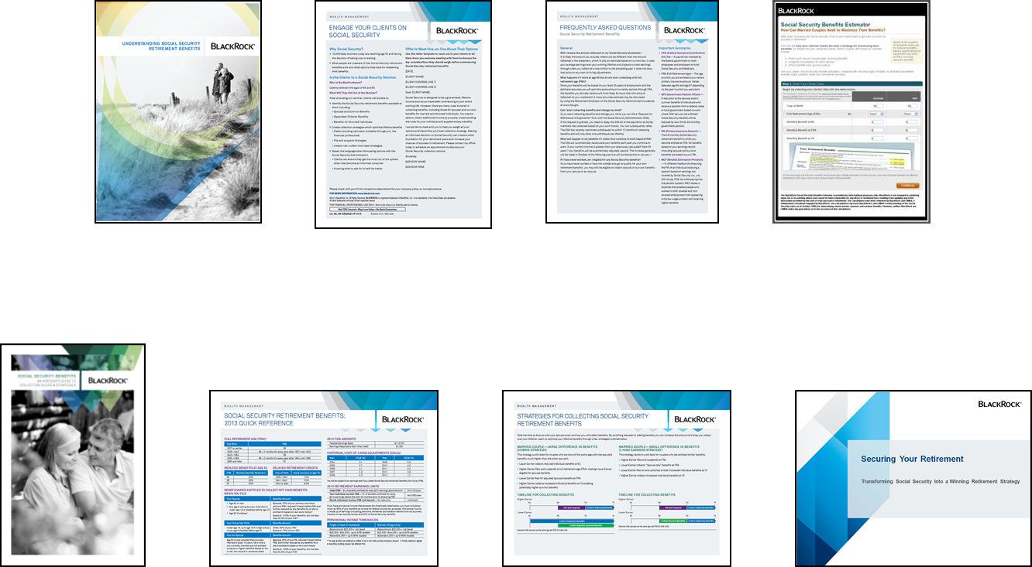
BlackRock Social Security Resources
Understanding Social Security Retirement Benefits
Engage Your Clients on Social Security
Frequently Asked Questions: Social Security Retirement Benefits
Social Security Benefits Estimator
Social Security Benefits FP Guide
Social Security Retirement Benefits: Quick Reference
Strategies for Collecting Social Security Retirement Benefits
Securing Your Retirement
Not all pieces referenced may be available at your firm. Please check with your firm's compliance department on the status of approved literature.
Notes:
32

Slide 33
Government Pension Offset (GPO)
Your pension could reduce your spousal or survivor benefits
Pension
$1,500
Offset
$1,000
X 2/3
=
Spousal Benefits $1,100
Survivor Benefits $2,200
$100
$1,200
Notes:
Some employees, usually civil service employees, do not pay into the Social Security Retirement System, but rather a civil retirement system. Since their years of employment would not be recognized by SS as a result of this, they would be entitled to receive spousal and survivor benefits. Social Security will offset those benefits however as a result of your Civil pension. They would reduce any spousal or survivor benefits by 2/3 of your civil pension. So you would receive your full civil pension and any additional spousal benefits if they exceeded 2/3 of your pension. For instance, in the above scenario, the wife would receive $1,500 from her pension, and an additional $100 as a spousal benefits. If her husband passed away, she would continue to receive her pension and a survivor benefits reduced by $1,000.

Slide 34
Windfall Elimination Provision (WEP)
Your pension could reduce your own benefits
Age 22
Age 32
Age 42
Age 52
Age 62
Teacher
Lockheed Martin
Lockheed Martin
PIA = 90% + 32% + 15%
of the first $826* of AIME
of the next $4,154* of AIME
of AIME over $4,980*
WEP
PIA = 90% + 32% + 15%
PIA = 40% + 32% + 15%
of the first $826* of AIME
of the next $4,154* of AIME
of AIME over $4,980*
* Changed annually by changes in the national indexing average wage. Numbers for 2015.
Source: Social Security Administration (www.ssa.gov).
Notes:
WEP is phased out for individuals who have substantial earnings covered by Social Security between 20–30 years

Slide 35
Married Couple – Intermediate Difference in Benefits
John PIA: $2,200 Lives through age 75
Jane PIA: $1,000 Lives through age 82
Age 62
66 (FRA)
70
74
John
Collect Spousal - $500
$2,904
Collect Individual Benefits - $750
Jane
$100
Both Age 62 | Both FRA | Both Age 70 | Strategy
$863,820 | $976,800 | $1,054,944 | $1,060,704

Slide 36
Widow – Lower Individual Benefits
Wendy PIA: $1,000 Survivor: $2,500 Lives through age 92
Age 60
62
66 (FRA)
70
72
Individual - $750
Collect Survivor Benefits - $2,500
Age 62 | FRA | Age 70 | Strategy
$753,300 | $810,000 | $690,000 | $846,000

Slide 37
Welcome to the new world of retirement
We work with you – for them.
At BlackRock, we’re working with advisors like you – and some of the world’s largest pension funds, DC plans, companies, and governments to make sure that millions of investors around the globe can enjoy the retirement they deserve.
Providing answers in a world of questions
The new world of investing is more challenging than ever. So we make this promise to you: no matter how the financial landscape may shift, we will help you adapt. We’ll provide answers to help you lead the way and achieve the best possible investment outcomes for your clients..
BlackRock was built for these times
With 85% of the assets we manage dedicated to securing people’s retirements, BlackRock can help ensure that those who’ve spent their lives working hard and making sacrifices can spend their retirement doing just the opposite.

Slide 38
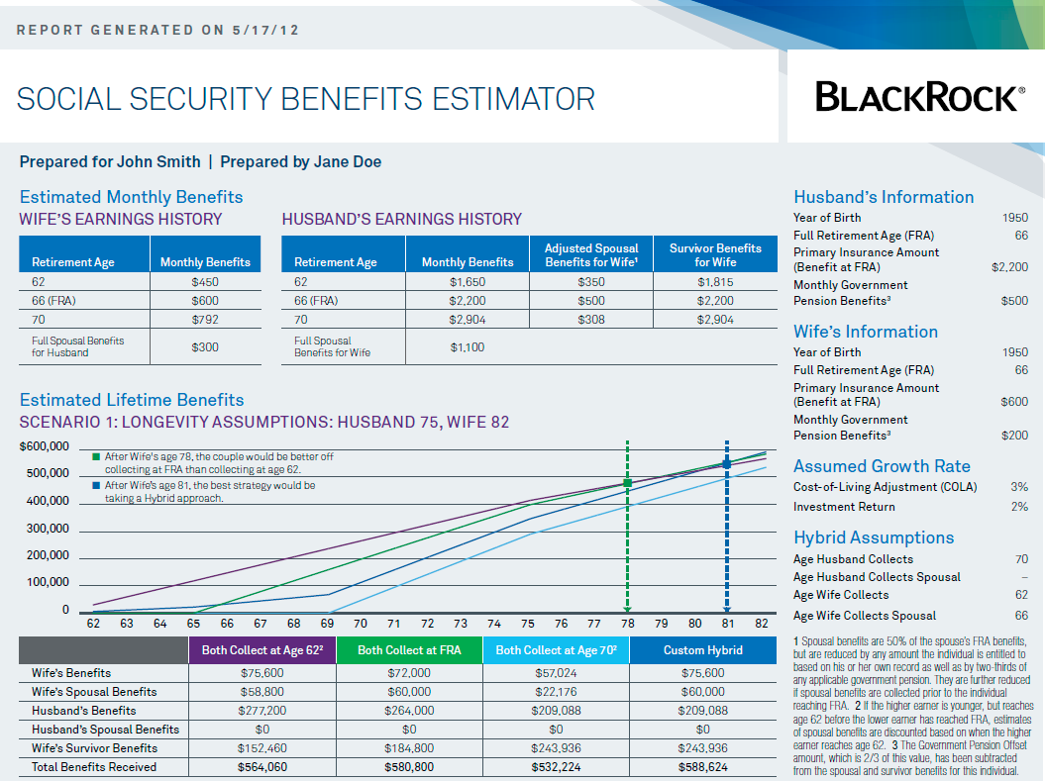
Social Security Tool Output
Notes:
Here is an example report from Blackrock's Social Security Calculator- that uses both a husbands and a wife's benefit information (walkthrough sample output). You can access this tool through our tool center.

Slide 39
First Input Screen

Slide 40
Second Input Screen – Reference Table

Slide 41
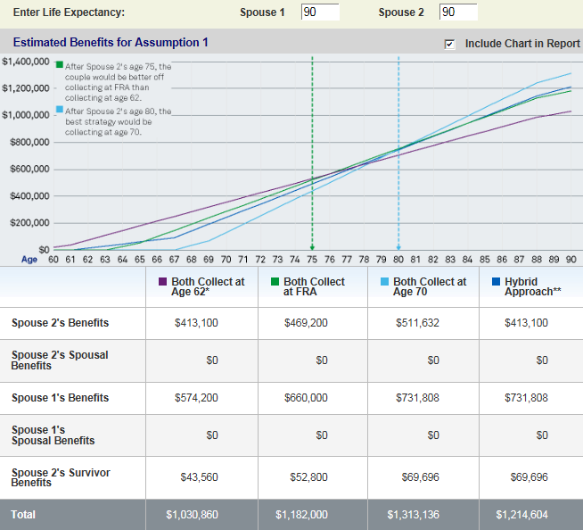
Second Input Screen – Estimated Lifetime Benefits

Slide 42
Second Input Screen – Optional Inputs

Slide 43
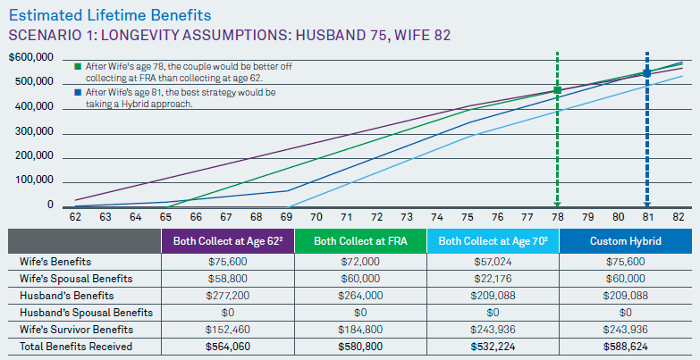
Social Security Benefits Estimator

