Slide 1
PLANNING FOR LONG TERM CARE

Slide 2
LONG TERM CARE
A specialized care delivery system for persons with chronic illness or advanced ageing who need assistance with medical care, the activities of daily living or a closed living environment.

Slide 3
VENUES
Facility Based Care
The patient is a resident in a facility which provides the level of care needed. This includes Assisted Living, Skilled Health Care, Alzheimer’s Care and Special Care Facilities

Slide 5
Assisted Living Costs
Monthly fees cover apartment, food and general use of the facility
Additional amount for the level of care
Usually level 1-5 fees range from $500.00 to $2,000.00 per month extra
This arrangement can be as expensive as a Skilled Nursing Home
Is keeping certain cases out of the SNF

Slide 6
Assisted Living
Can provide a high level of care which is close to that of a Skilled Healthcare Facility
Because of this patients can remain in assisted living longer and maybe not “graduate” to the SNF
There are 48 Assisted Living Facilities in Colorado Springs

Slide 7
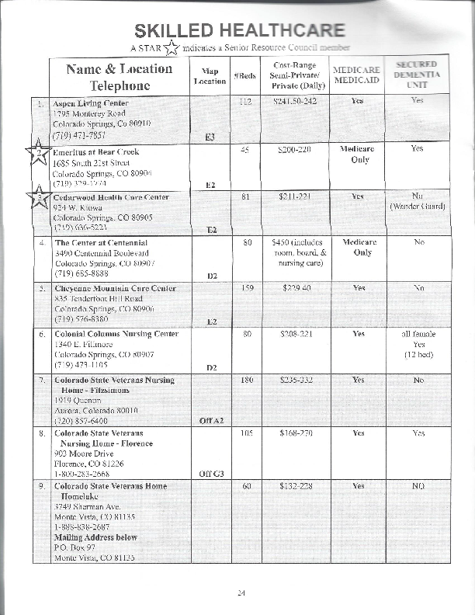

Slide 8
Skilled Healthcare Costs
Levels of Care available
  Skilled Care: formal routine of medical attention provided by a licensed care giver under the supervision of an MD.
  Custodial Care: informal care and supervision following a formal plan of care and can be administered by an aide
  Daily fee covers room rent, food and level of care received. Additional fees may apply

Slide 9
Skilled Health Care
Fees range from $180.00 to $300.00 per day depending on the level of care and the accommodations
There are 26 Skilled Nursing Facilities in Colorado Springs
In larger metropolitan areas, the costs can be substantially higher

Slide 10
Alzheimer’s or Special Care
Room fees by the day or month include care and food-incidental items are extra
Can be a special unit or floor of a SNF
Higher staff to patient count than in other care venues

Slide 11
VENUES
Community Based Care
Care is administered at home on a part time basis or the patient goes to a facility for treatment and returns home each day
Includes Home Health Care, Adult Day Care, Hospice Care

Slide 12
Home Health Care
Same levels of care are available at home as in a SNF but on a part time or “shift” basis: one treatment/visit or 2 hours per day and night sitters are examples
Fees vary according to the expertise and licensing of the care giver and their time used
This can be the most expensive care

Slide 13
Adult Day Care
Provides skilled and custodial care to patients on a daily or half day basis: patient returns home after session
Can provide physical, speech, respiratory and occupational therapy or general supervisory activities
Transportation to and from and lunch is also available

Slide 14
Additional Info
In 2013, the average cost per day for Long Term Care Services in the Pikes Peak Region is $220.00 per day. Actual expenses can be higher or lower depending on the type of care, frequency and facility used
If you plan on receiving care in another community, check out the facilities available and costs

Slide 15
Paying For Long Term Care

Slide 16
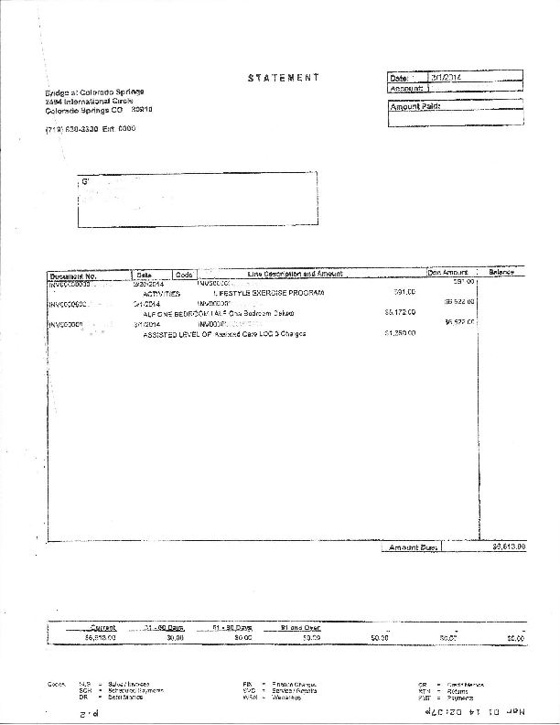

Slide 17
Sources
Personal Resources
Cash, savings ; etc.
Investment accounts
Fixed asset liquidation
Relatives

Slide 18
Sources
Medicaid-after all resources are exhausted…
-Must meet asset and income levels
Medicaid pays for care in a Medicaid facility
State actuaries estimate that on the present course, Medicaid will be out of business by 2025

Slide 19
Health Insurance
-Individual or group plans may offer small amounts of recuperative care: 30-100 days is usual
The ACA has no provisions for LTC
Medicare will pay for 100 days of skilled care following an inpatient stay of at least 72 hours. Also provides skilled home health care up to $2200.00 per year in this region-patient must be “home bound”

Slide 20
Long Term Care Insurance
Can be structured to meet specific financial and emotional needs
Provides a flow of cash to offset the cost
Covers licensed care venues
Can be coordinated with available cash resources to provide coverage
Can protect an estate and financial plan from a forced liquidation

Slide 21
LTCI Components
Elimination period
Daily or monthly benefit
Inflation increase option
Maximum benefit
Waiver of premium
Additional riders
Claims are paid after the event

Slide 22
LTCI Claim Triggers
Patient must be either functionally or cognitively impaired
Functional: needs assistance with 2 out of 6 activities of daily living: bathing, dressing, feeding, transferring, toileting and maintaining continence
Cognitive impairment: as determined by an MD using accepted testing protocols

Slide 23
Partnership Policies
Agreement with the state as follows:
One owns a qualifying LTC policy and uses it up for care yet still needs care
Any amount paid out by the policy, can be deducted from the patient’s total cash asset amount in the Medicaid spend down process. This amount is sheltered and can be used for other purposes: inheritance, gift; etc.

Slide 24
Other Health Insurance
Catastrophic illness policies- only pay out under certain diagnosis codes
Ageing, accidents and post surgical rehab don’t count
Will NOT qualify as a partnership policy

Slide 25
Life and Annuity Policies
Provide LTC on riders to either plan
If need LTC, use the death benefit or cash value first then the LTC rider
$$ used to buy the policy should be from excess funds so no withdrawals are made except for LTC
Will NOT qualify as a partnership plan
May not be the best use of capital

Slide 26
Planning Idea-1
Use a partnership LTC policy with a return of premium rider. If the policy is used up, a similar amount of $$ is sheltered from Medicaid
If the policy isn’t used, the total amount of premiums paid is reimbursed
Use funds from IRA withdrawals to pay the premium: actual cost of coverage is the income tax paid on the withdrawals

Slide 27
Planning Idea-2
Buy a Life Insurance policy or an Annuity with a LTC rider
Must be willing to use up the core policy first
May never get to the LTC benefit
If make non-LTC withdrawals from either plan, may have to pay for the LTC rider
NOT partnership qualified

Slide 28
Sources of Premiums
Investment accounts
Family member(s)
Income

Slide 29
Reality Check
At any age, there is a 50% chance of needing some form of LTC
After age 65, this increase by 10% every 5 years
20% of the people in nursing homes are UNDER age 65
Not many people can pay in today’s $$ $80,000.00 + per year per person for care

Slide 30
The Truth of the Matter
This is a potentially devastating risk to an estate or financial plan
Health insurance including Medicare will provide minimal coverage
Clients need to fully understand the ramifications of this risk and work with planners to manage it
Being on the denial train isn’t acceptable…

Slide 31
THANK YOU

